Slide 1
Linear Algebra(MAT204) Faculty – Prof. Gaurav Goswami
Object Detection Using R-CNN
Group - 14

Slide 2
Group No. – 14
NAME | ROLL NUMBER
Tirth Patel | AU1940137
Nipun Patel | AU1940033
Neel Shah | AU1940055
Kuldeep Gohil | AU1940159

Slide 3
Introduction
Object detection is a computer vision technique that allows us to identify and locate objects in an image or video.
With this kind of identification and localization, object detection can be used to count objects in a scene and determine and track their precise locations, all while accurately labeling them.
Object detection is used for many different purposes like image retrieval, security, machine inspection and many more.

Slide 4
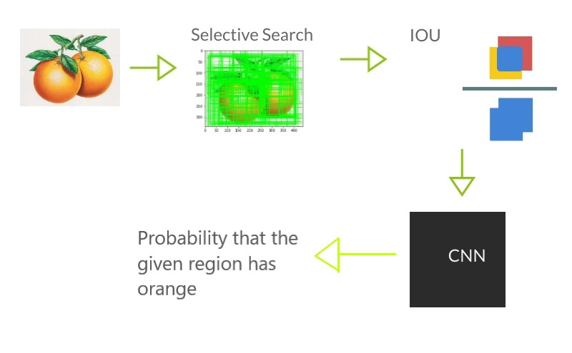
Flow of RCNN Algorithm

Slide 5
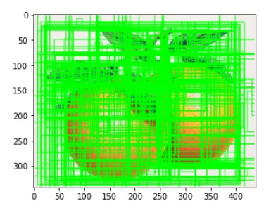
Selective Search
Selective search takes the input of image and returns region proposals in sorted order. The number of region proposals generated by selective search is not fixed.
Selective search firstly performs segmentation on the image.
Then all the points in the image matrix are grouped together with neighbouring points based on similarities in colour, texture, size and shape.
We used open CV library in order to apply selective search.

Slide 6
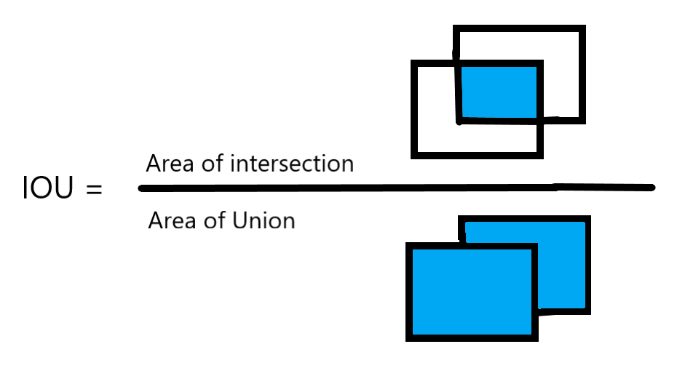
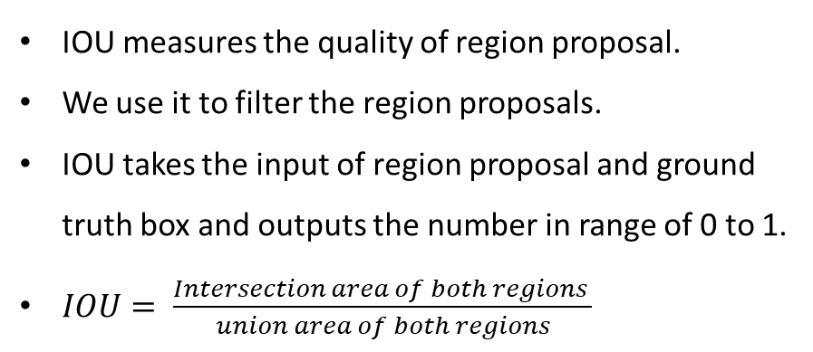
Intersection Over Union
IOU measures the quality of region proposal.
We use it to filter the region proposals.
IOU takes the input of region proposal and ground truth box and outputs the number in range of 0 to 1.
$IOU= \frac{Intersection area of both regions }{union area of both regions}$

Slide 7
Convolutional Neural Network
A Convolutional Neural Network (ConvNet/CNN) is a Deep Learning algorithm which can take in an input image, assign importance (learnable weights and biases) to various aspects/objects in the image and be able to differentiate one from the other.
CNN has three main types of layers-
Convolution Layer
Pooling Layer(Max pool/Average Pool)
SoftMax Layer(Dense Layer + SoftMax Activation Function)

Slide 8
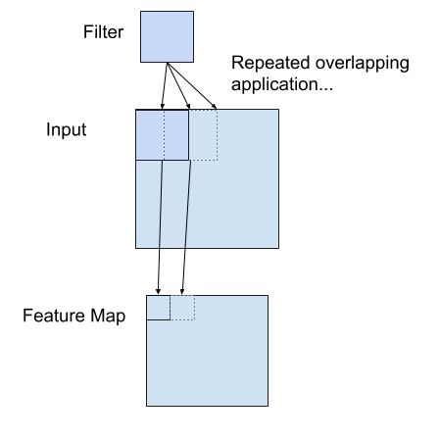
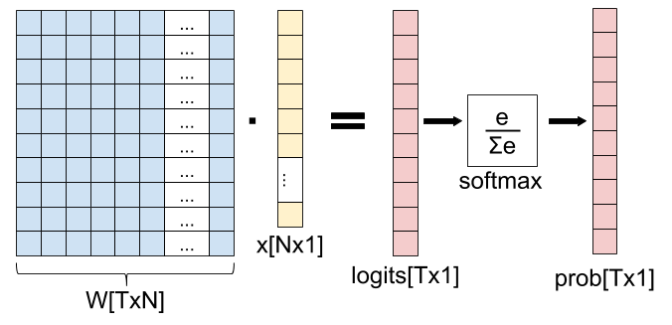
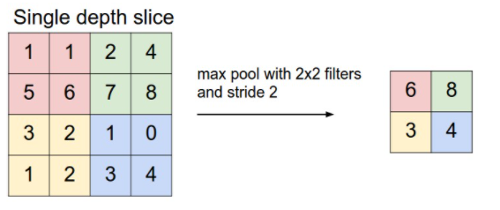
Convolutional Layer
Max Pooling Layer
SoftMax Layer

Slide 9
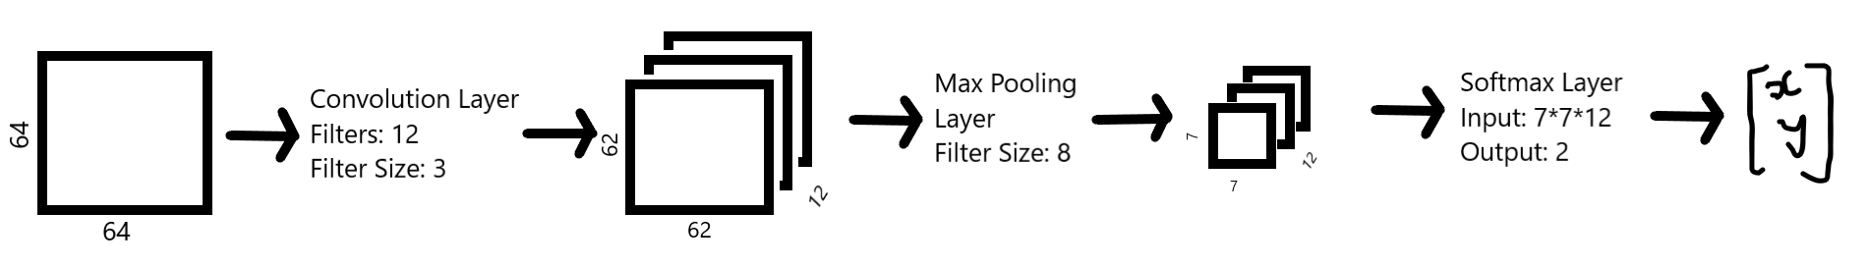
Our CNN Model
We have implemented a small neural network using numpy as shown in the image below.
Our Neural network only works with grayscale images.

Slide 10
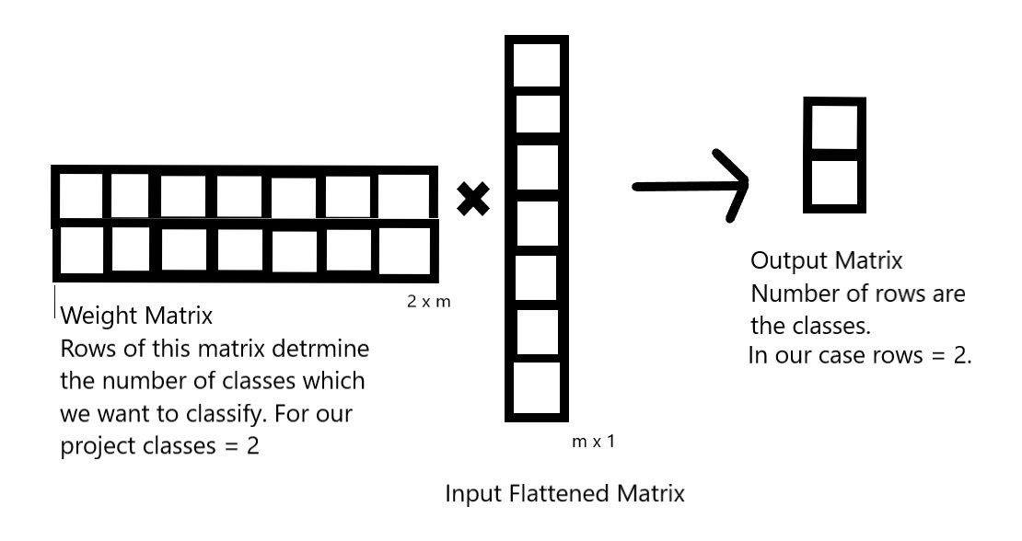
Linear Algebra in Neural Networks
The main idea is to extract features and learn the desired features.
Neural Network uses Linear Transformation concept and produces different number of features in different dimensions. The image shows the intermediate step of our neural net.
WX = Z
W- weight matrix, X- Input Matrix, Z- output vector.

Slide 11
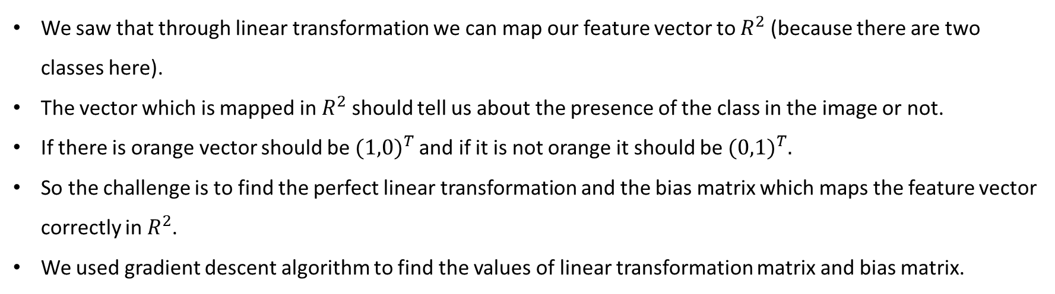
How all the things fit!
We saw that through linear transformation we can map our feature vector to $R^{2}$ (because there are two classes here).
The vector which is mapped in $R^{2}$ should tell us about the presence of the class in the image or not.
If there is orange vector should be ${(1,0)}^{T}$and if it is not orange it should be ${(0,1)}^{T}.$
So the challenge is to find the perfect linear transformation and the bias matrix which maps the feature vector correctly in $R^{2}$.
We used gradient descent algorithm to find the values of linear transformation matrix and bias matrix.

Slide 12
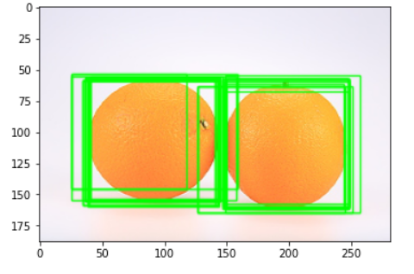
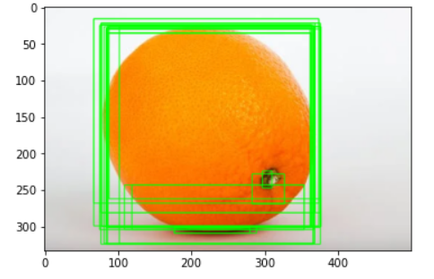
Output
Limitations: Our model doesn’t work well when there are multiple oranges in the image. Also some times many bounding boxes are generated for a single object.

Slide 13
Conclusion
We successfully implemented RCNN algorithm and performed localization with the accuracy of more than 70%.
We learned how the features are extracted from the image and are manipulated in order to detect some specific object. We learned the math behind the Convolution Neural Network and saw how the concepts of linear algebra are used in Machine Learning Domain.

Slide 14
References
https://www.cv-foundation.org/openaccess/content_cvpr_2014/papers/Girshick_Rich_Feature_Hierarchies_2014_CVPR_paper.pdf
https://cs231n.github.io/convolutional-networks/
https://eli.thegreenplace.net/2016/the-softmax-function-and-its-derivative/

Slide 15
Thank You!

